Slide 1
Microprocessor Architecture ECE4375/5375
Dr. Argenis Bilbao
Spring 2026

Slide 2
Presentation Outline
CPU Architectures
Computer Buses

Slide 3
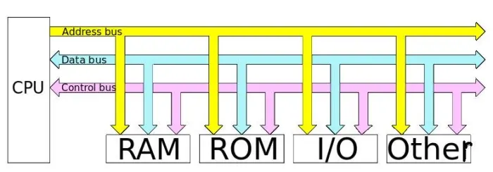
The 8088 Computer Architecture
All devices are connected to the CPU bus (8-bit bus)
Advantages
Simplicity
Disadvantages
High amounts of congestion
CPU is completely halted if two devices are communicating between each other (DMA, CPU with no cache)
IBM 8086 and 286 used
the same topology but with
a 16-bit bus.
ISA Bus was predominant

Slide 4
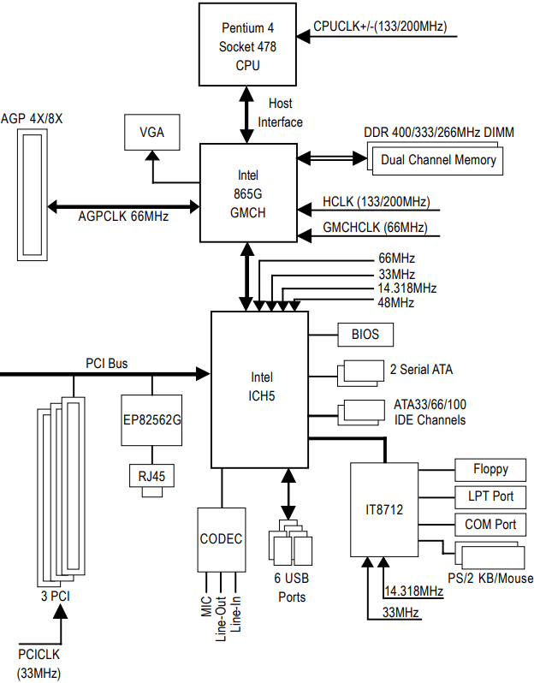
A More Complicated System
Starting with the original Pentium, a “north
bridge was used between the CPU bus
and the rest of the buses in the system
32-bit CPU bus from 486 to original
Pentium
Advantages
Allowed for multiple buses to exist within
a computer system
These busses could be using DMA to
communicate between devices.
Theoretically unlimited number of CPUs
in the system
Disadvantages
Obviously more complicated system
Memory no longer connected directly to
CPU
Congestion in the CPU bus

Slide 5
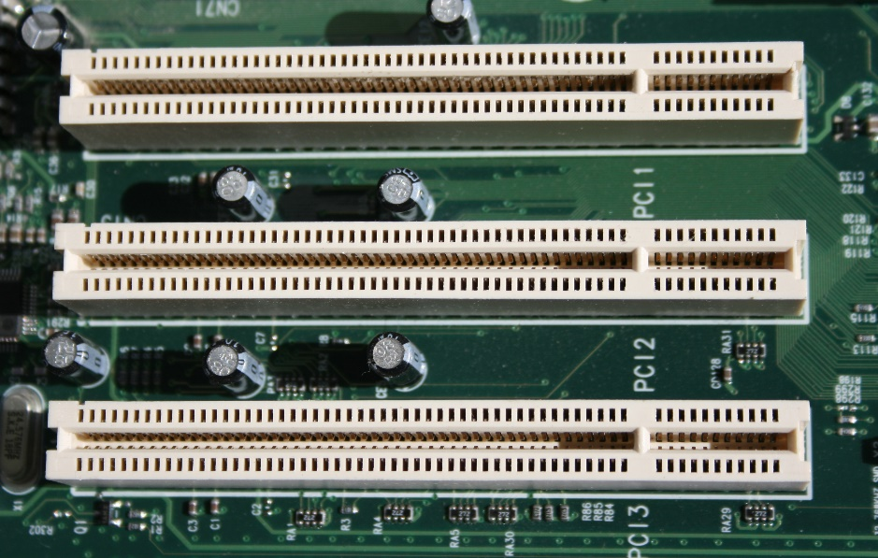
The PCI Bus
32-bit/64-bit address and data bus
Advantages over ISA bus
Increased bandwidth from 16Mb/s to 1067Mb/s for base version to 8.5 Gb/s for PCI-X 133 MHz
Platform independent bus (also used in Apple systems and others)
Disadvantages
Still uses a shared bus so only two devices can communicate at the same time if on the same bus

Slide 6
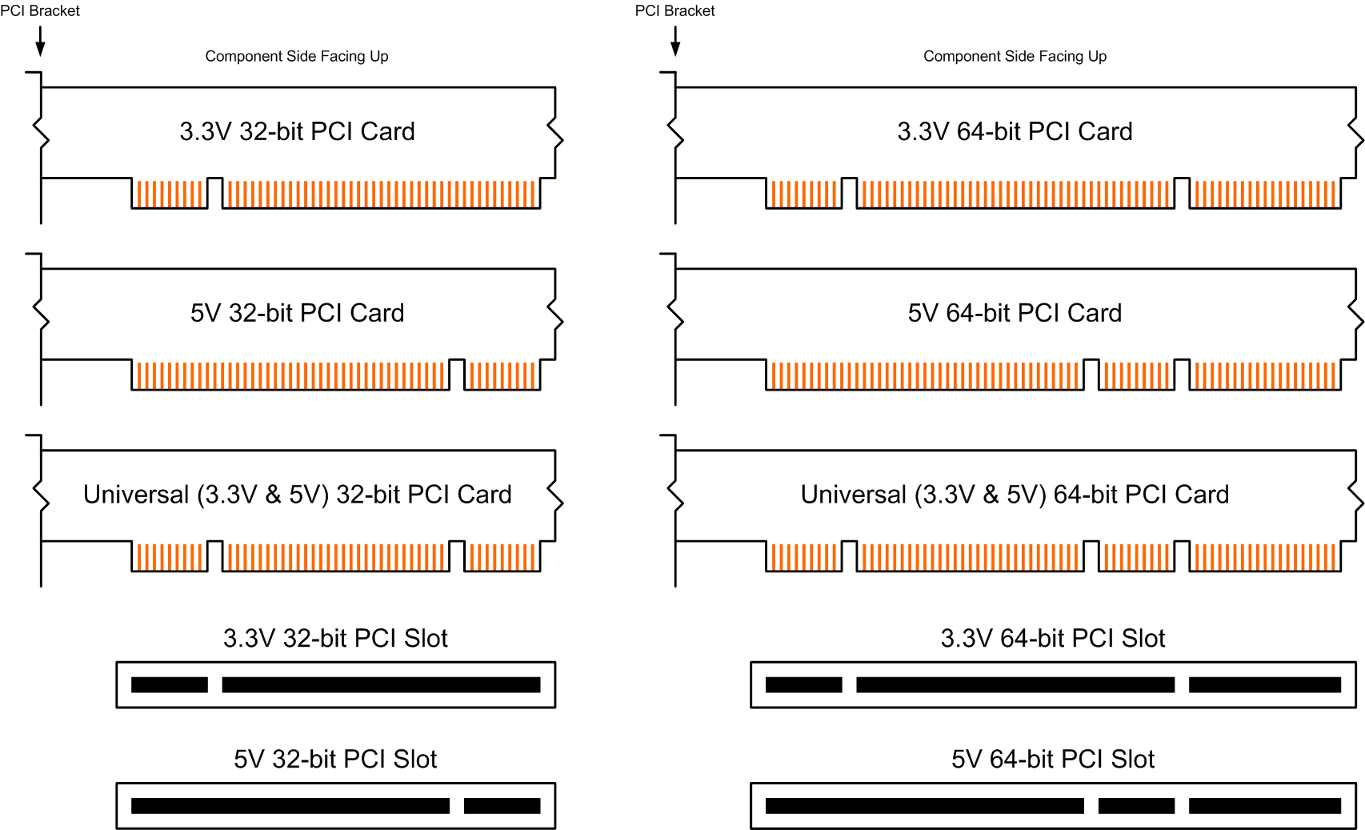
The PCI Bus

Slide 7
The PCI Bus Pins
http://www.interfacebus.com/Design_PCI_Pinout.html

Slide 8
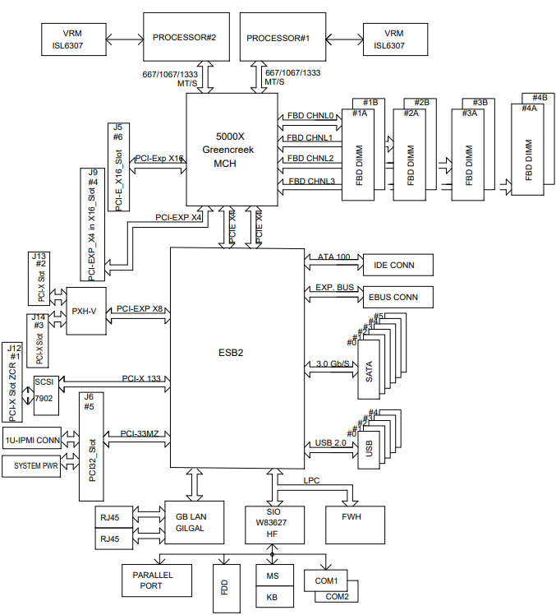
An Even More Complicated System
64-bit CPU bus from Pentium 4 to
present
Still was plagued by the same
“bottlenecking” issue as machines
before it
Manufacturers tried to remedy the
problem by increasing FSB speed
and increasing the number of
memory channels in server
machines
Enough is enough!

Slide 9
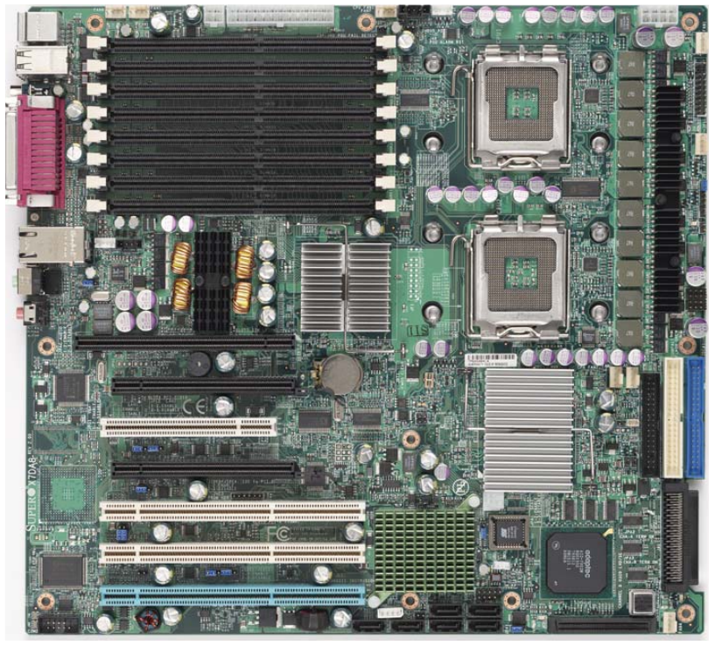
An Even More Complicated System

Slide 10
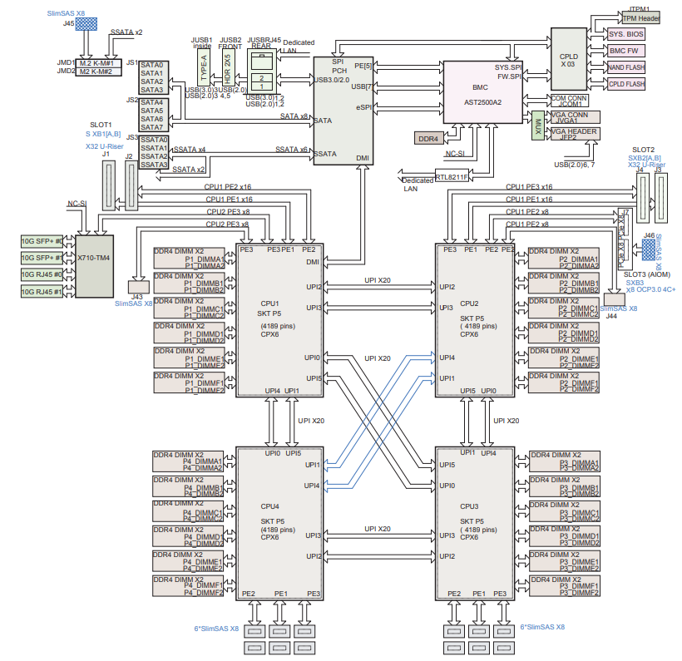
Systems We Enjoy Today
4th Generation Xeon Scalable
machine
No north bridge!
Memory directly attached to
the CPU (internal memory
controller)
Ultra path interconnect (UPI) between CPUs to allow other CPUs to access the memory
UPI also used to keep cache coherency between CPUs

Slide 11
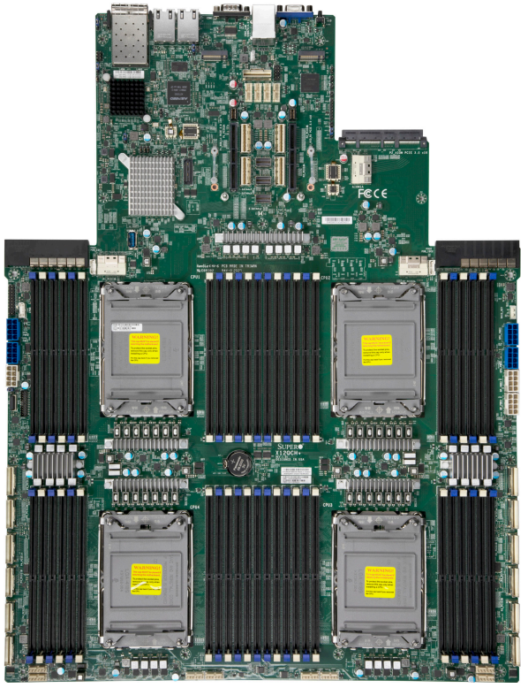
Systems We Enjoy Today

Slide 12
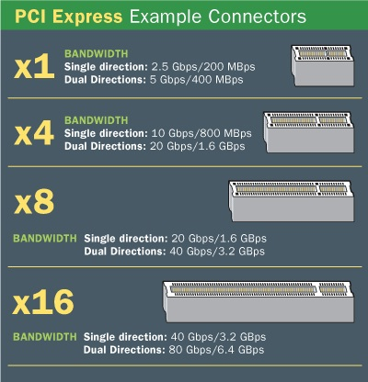
PCIe Bus
Version 1.x: 2.5 GT/s
x1: 250 MB/s
x16: 4 GB/s
Version 2.x: 5 GT/s
x1: 500 MB/s
x16: 8 GB/s
Version 3.x: 8 GT/s
x1: 985 MB/s
x16: 15.75 GB/s
Version 4.0: 16 GT/s
x1: 1.97 GB/s
x16: 31.5 GB/s
Version 5.0: 32 GT/s
x1: 3.94 GB/s
x16: 63 GB/s
Version 6.0: 64 GT/s
x1: 7.56 GB/s
x16: 121 GB/s
Version 7.0: 128 GT/s
x1: 15.13 GB/s
x16: 242 GB/s

Slide 13

PCIe 1x Slot Pins
Pin | Side B Connector |  | Side A Connector
# | Name | Description | Name | Description
1 | +12v | +12 volt power | PRSNT#1 | Hot plug presence detect
2 | +12v | +12 volt power | +12v | +12 volt power
3 | +12v | +12 volt power | +12v | +12 volt power
4 | GND | Ground | GND | Ground
5 | SMCLK | SMBus clock | JTAG2 | TCK
6 | SMDAT | SMBus data | JTAG3 | TDI
7 | GND | Ground | JTAG4 | TDO
8 | +3.3v | +3.3 volt power | JTAG5 | TMS
9 | JTAG1 | +TRST# | +3.3v | +3.3 volt power
10 | 3.3Vaux | 3.3v volt power | +3.3v | +3.3 volt power
11 | WAKE# | Link Reactivation | PERST# | PCI-Express Reset signal
Mechanical Key
12 | RSVD | Reserved | GND | Ground
13 | GND | Ground | REFCLK+ | Reference Clock Differential pair
14 | HSOp(0) | Transmitter Lane 0, Differential pair | REFCLK-
15 | HSOn(0) |  | GND | Ground
16 | GND | Ground | HSIp(0) | Receiver Lane 0, Differential pair
17 | PRSNT#2 | Hotplug detect | HSIn(0)
18 | GND | Ground | GND | Ground

Slide 14
Sources
http://www.eecs.harvard.edu/cs146-246/
Assigned Textbook
https://www.supermicro.com/

